Slide 1
CHECKPOINT #2
Manmeet Singh Hayer
CSC498: SENIOR SEMINAR
THURSDAY OCT 9, 2025

Slide 2
AGENDA
Recap & Background
Watchlist & Portfolio Features
Candlestick Charts (Multi-Year + Volume)
Fundamentals Integration
Demo Walkthrough
Challenges & Next Steps

Slide 3
BACKGROUND
Finvestor = stock-market education web app
Expands beyond checkpoint #1’s home dashboard
Adds real data persistence (via PostgreSQL)
Backend + frontend now linked through FastAPI routes
Goal: make financial learning interactive & data-driven

Slide 4
FIRST CHECKPOINT PROMISES
Home Page: Full with search bar, market overview & finance tips
Sidebar with main pages: Home, Ticker, Watchlists, Portfolios, Compare, Methods
Tickers: Candlestick shows open, high, low, close (OHLC); volume bars included as well
Time ranges: 1M, 3M, 6M, 1Y, 5Y, MAX

Slide 5
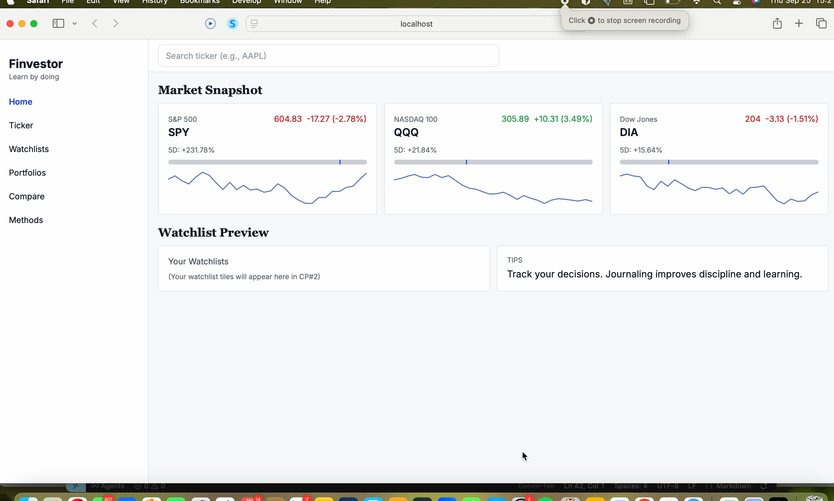
DEMONSTRATION

Slide 6
QUESTIONS?
THANK YOU!

